Slide 1
Lecture 5 Algorithm Performance Analysis
Department of Computer Science
Hofstra University
1

Slide 2




Motivation
Algorithm: a strategy for solving a problem.
Algorithm with good performance can answer very hard questions in very short amount of time. We need to have a sense of how good our algorithm is without just running it.
Performance: how good that strategy is.
There is hereby imposed on the taxable income of every individual (other than a surviving spouse as defined in section 2(a) or the head of a household as defined in section 2(b)) who is not a married individual (as defined in section 7703) a tax determined in accordance with the following table:
How long dose this take?
If you are single, never lost your spouse, and not the head of a household, you pay taxes according to the following table:
Use flesch score to measure of text readability
Problem with just looking at the “stopwatch” time.
different computers
different compilers
different libraries/optimizations
The time for running the specific code on a specific machine on a specific input
Is NOT a good representation of how good our algorithm is.
2

Slide 3
Performance Analysis Overview
Count number of operations instead of time’
# operations is independent of the hardware platform
Focus on how performance scales with large input size
Asymptotic complexity refers to the study of how an algorithm's resource usage (such as time or space) grows relative to the size of its input as the input size approaches infinity.
Input
Algorithm
Output
3
Notes:
Asymptotic Performance Analysis
Start at first index of array/list
While current index is less than length:
count syllables large input, more operations
small input, less operations

Slide 4
Algorithm runtime
boolean hasLetter(String word, char letter)
{
for (int i = 0; i < word.length(); i++) {
if (word.charAt(i) == letter) {
return true;
}
}
return false;
}
Algorithm runtime is dependent on the inputs.
hasLetter(“Happy”, a): search for the letter “a” in the word “Happy”, loop runs for 2 iterations before finishing and returning true.
hasLetter(“Happy”, x): search for the letter “x” in the word “Happy”, loop runs for 5 iterations before finishing and returning false.
4
Notes:
- algorithm performance depends on the combination of both inputs

Slide 5
Asymptotic Analysis
Asymptotic analysis examines how functions behave as their input grows arbitrarily large. It focuses on the limiting behavior of functions for large input size, rather than their exact values for specific inputs.
Runtime as input size n gets large, as we don’t care if the algorithm runs for 10 ms vs. 2 s with small input size n; we care if it runs for 100 s vs. 100 hours/days/years for very large n.
Big-O Notation (O-notation) denotes upper bound
Theta Notation (Θ-notation) denotes exact bound
Omega Notation (Ω-notation) denotes exact bound
5
Notes:
exact runtime usually not worth the effort asymptotic efficiency Asymptotic comparison operator Numeric comparison operator
Algorithm is o( something ) A number is < something
Algorithm is O( something ) A number is ≤ something
Algorithm is Θ( something ) A number is = something
Algorithm is Ω( something ) A number is ≥ something
Algorithm is ω( something ) A number is > something
Other notations represent more finer-grained asymptotic analysis, such as lower and upper bound. We focus on big-O for the tightest upper bound.

Slide 6
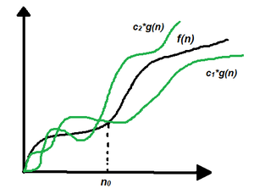
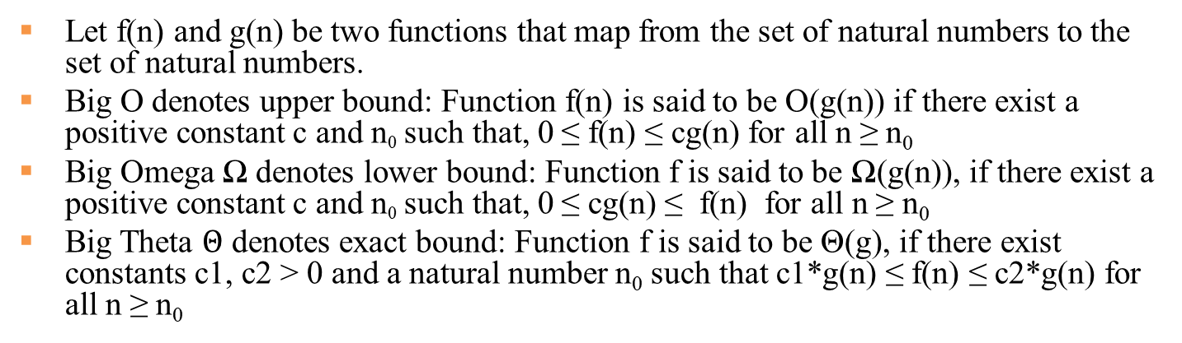
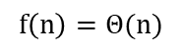
Three Notations
Let f(n) and g(n) be two functions that map from the set of natural numbers to the set of natural numbers.
Big O denotes upper bound: Function f(n) is said to be O(g(n)) if there exist a positive constant c and n₀ such that, 0 ≤ f(n) ≤ cg(n) for all n ≥ n₀
Big Omega Ω denotes lower bound: Function f is said to be Ω(g(n)), if there exist a positive constant c and n₀ such that, 0 ≤ cg(n) ≤ f(n) for all n ≥ n₀
Big Theta $Θ$ denotes exact bound: Function f is said to be Θ(g), if there exist constants c1, c2 > 0 and a natural number n₀ such that c1*g(n) ≤ f(n) ≤ c2*g(n) for all n ≥ n₀
$$f\left(n\right)=Θ(n)$$
https://www.geeksforgeeks.org/types-of-asymptotic-notations-in-complexity-analysis-of-algorithms/
6
Notes:
If f(n) describes the running time of an algorithm,

Slide 7
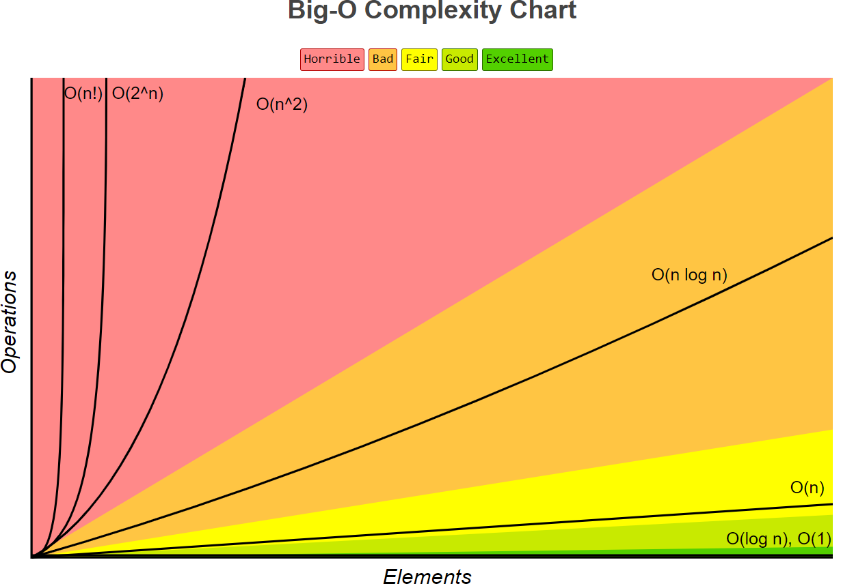
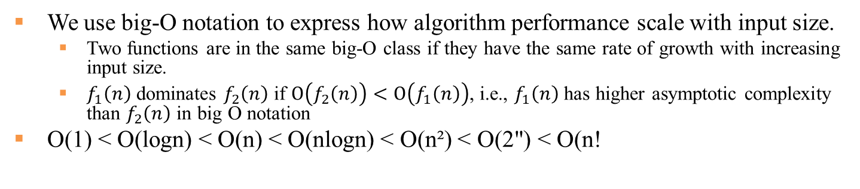
Big-O Complexity Chart
We use big-O notation to express how algorithm performance scale with input size.
Two functions are in the same big-O class if they have the same rate of growth with increasing input size.
$f_{1}\left(n\right)$ dominates $f_{2}\left(n\right)$ if $O\left(f_{2}\left(n\right)\right)<O\left(f_{1}\left(n\right)\right)$, i.e., $f_{1}\left(n\right)$ has higher asymptotic complexity than $f_{2}\left(n\right)$ in big O notation
O(1) < O(logn) < O(n) < O(nlogn) < O(n²) < O(2") < O(n!
https://www.bigocheatsheet.com/
7

Slide 8
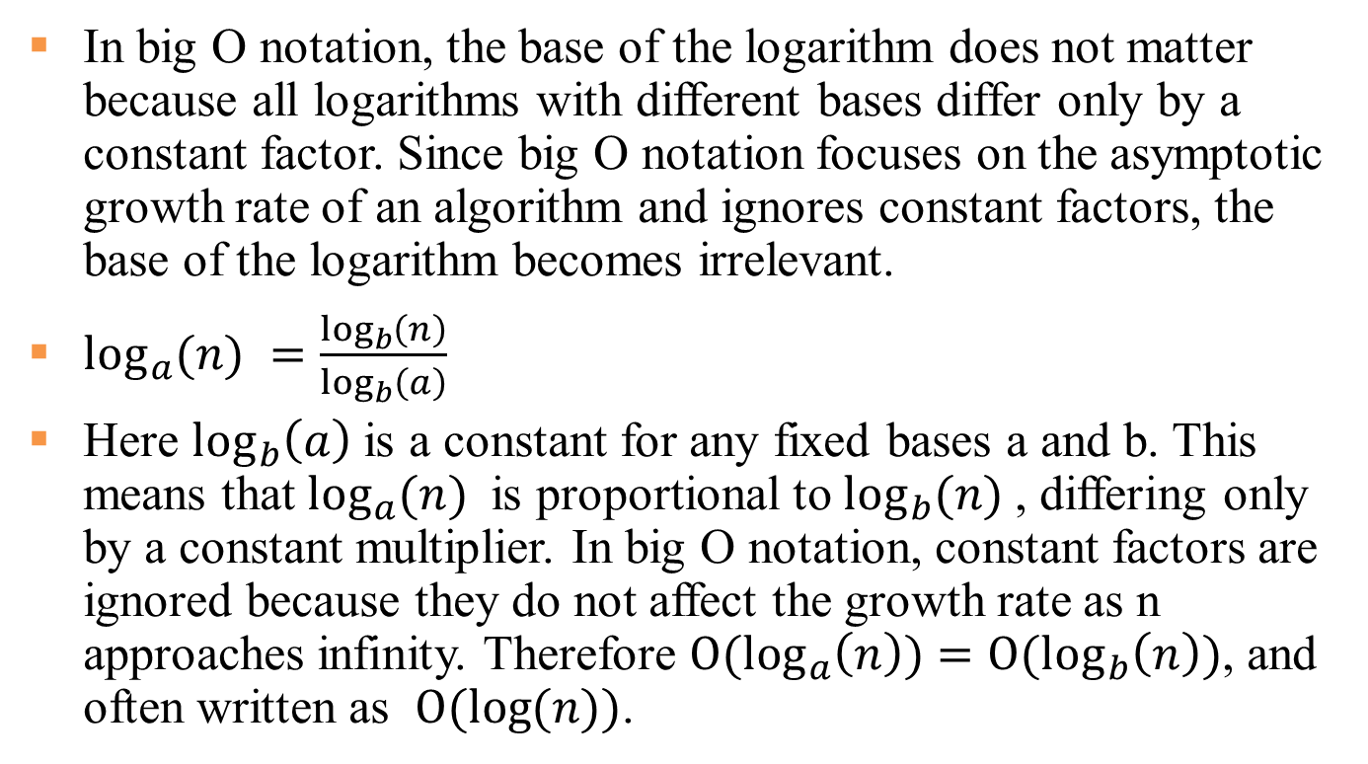
O(log n) Complexity
In big O notation, the base of the logarithm does not matter because all logarithms with different bases differ only by a constant factor. Since big O notation focuses on the asymptotic growth rate of an algorithm and ignores constant factors, the base of the logarithm becomes irrelevant.
$\log_{a}{(n) }=\frac{\log_{b}\left(n\right)}{\log_{b}\left(a\right)}$
Here $\log_{b}\left(a\right)$ is a constant for any fixed bases a and b. This means that $\log_{a}{(n) }$is proportional to $\log_{b}{(n) }$, differing only by a constant multiplier. In big O notation, constant factors are ignored because they do not affect the growth rate as n approaches infinity. Therefore $O(\log_{a}\left(n\right))=O(\log_{b}\left(n\right))$, and often written as $O(\log{(n)})$.
8

Slide 9
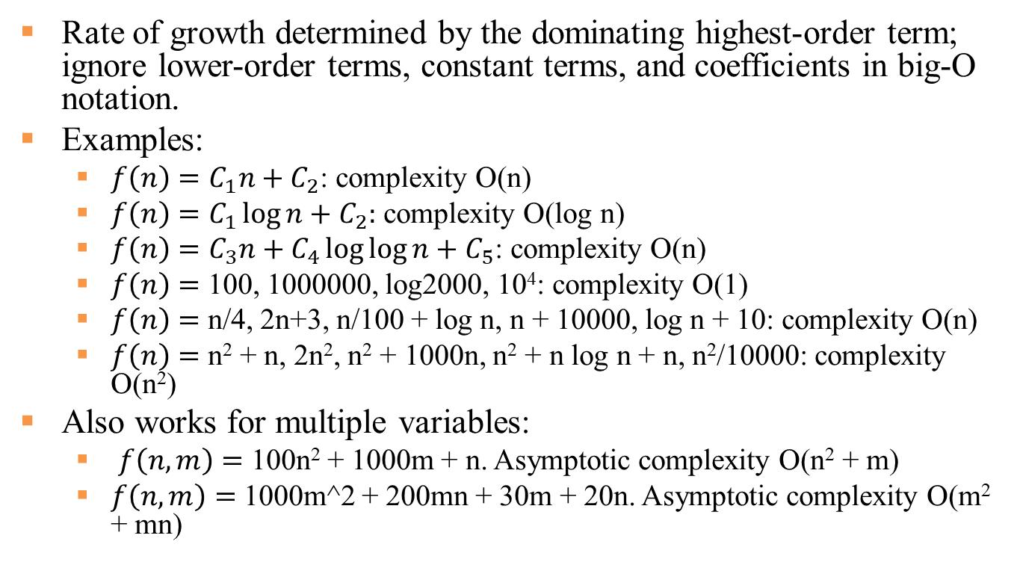
Big-O Notation Examples
Rate of growth determined by the dominating highest-order term; ignore lower-order terms, constant terms, and coefficients in big-O notation.
Examples:
$f\left(n\right)=C_{1}n+C_{2}$: complexity O(n)
$f\left(n\right)=C_{1}\log{n}+C_{2}:$ complexity O(log n)
$f\left(n\right)=C_{3}n+C_{4}\log{\log{n+C_{5}}}$: complexity O(n)
$f\left(n\right)=$ 100, 1000000, log2000, 10⁴: complexity O(1)
$f\left(n\right)=$ n/4, 2n+3, n/100 + log n, n + 10000, log n + 10: complexity O(n)
$f\left(n\right)=$ n² + n, 2n², n² + 1000n, n² + n log n + n, n²/10000: complexity O(n²)
Also works for multiple variables:
$f\left(n, m\right)=$ 100n² + 1000m + n. Asymptotic complexity O(n² + m)
$f\left(n, m\right)=$ 1000m^2 + 200mn + 30m + 20n. Asymptotic complexity O(m² + mn)
Big-O notation in 5 minutes
https://www.youtube.com/watch?v=__vX2sjlpXU
Big-O Notation in 3 Minutes
https://www.youtube.com/watch?v=x2CRZaN2xgM
9
Notes:
exact runtime usually not worth the effort asymptotic efficiency Asymptotic comparison operator Numeric comparison operator
Algorithm is o( something ) A number is < something
Algorithm is O( something ) A number is ≤ something
Algorithm is Θ( something ) A number is = something
Algorithm is Ω( something ) A number is ≥ something
Algorithm is ω( something ) A number is > something
Other notations represent more finer-grained asymptotic analysis, such as lower and upper bound. We focus on big-O for the tightest upper bound.

Slide 10
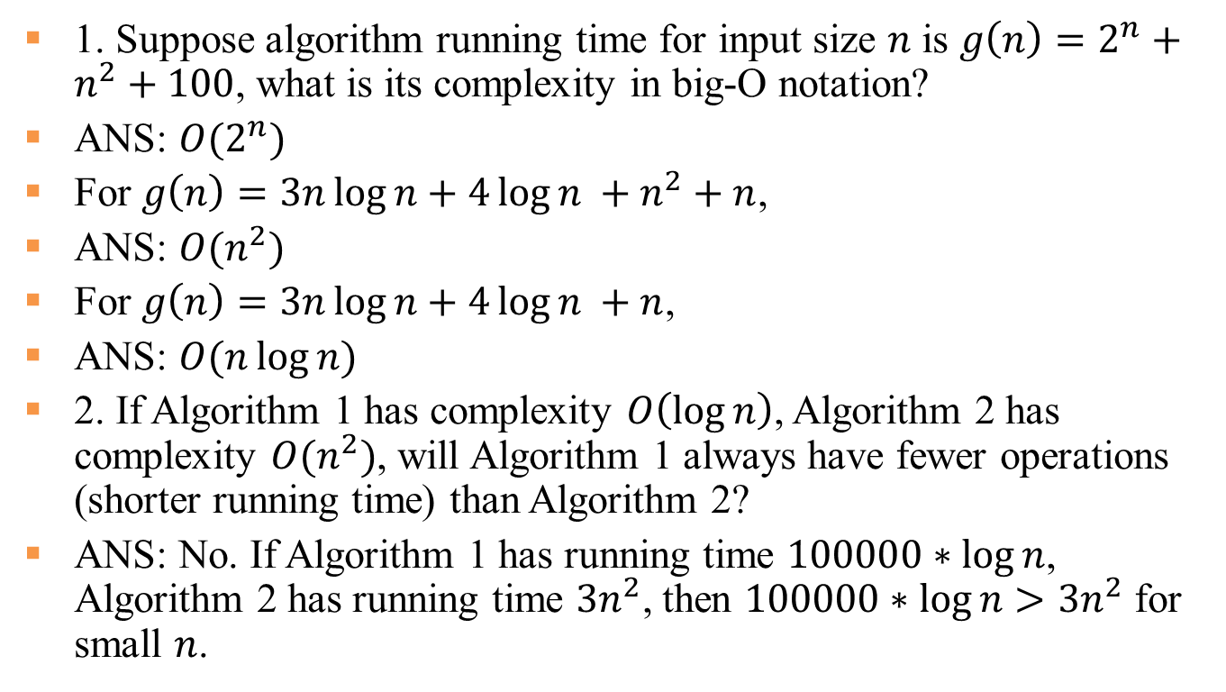
Exercise
1. Suppose algorithm running time for input size $n$ is $g\left(n\right)=2^{n}+n^{2}+100$, what is its complexity in big-O notation?
ANS: $O(2^{n})$
For $g\left(n\right)=3n\log{n}+4\log{n} +n^{2}+n$,
ANS: $O(n^{2})$
For $g\left(n\right)=3n\log{n}+4\log{n} +n$,
ANS: $O(n\log{n})$
2. If Algorithm 1 has complexity $O\left(\log{n}\right)$, Algorithm 2 has complexity $O(n^{2})$, will Algorithm 1 always have fewer operations (shorter running time) than Algorithm 2?
ANS: No. If Algorithm 1 has running time $100000∗\log{n}$, Algorithm 2 has running time $3n^{2}$, then $100000∗\log{n}>3n^{2}$ for small $n$.
10

Slide 11
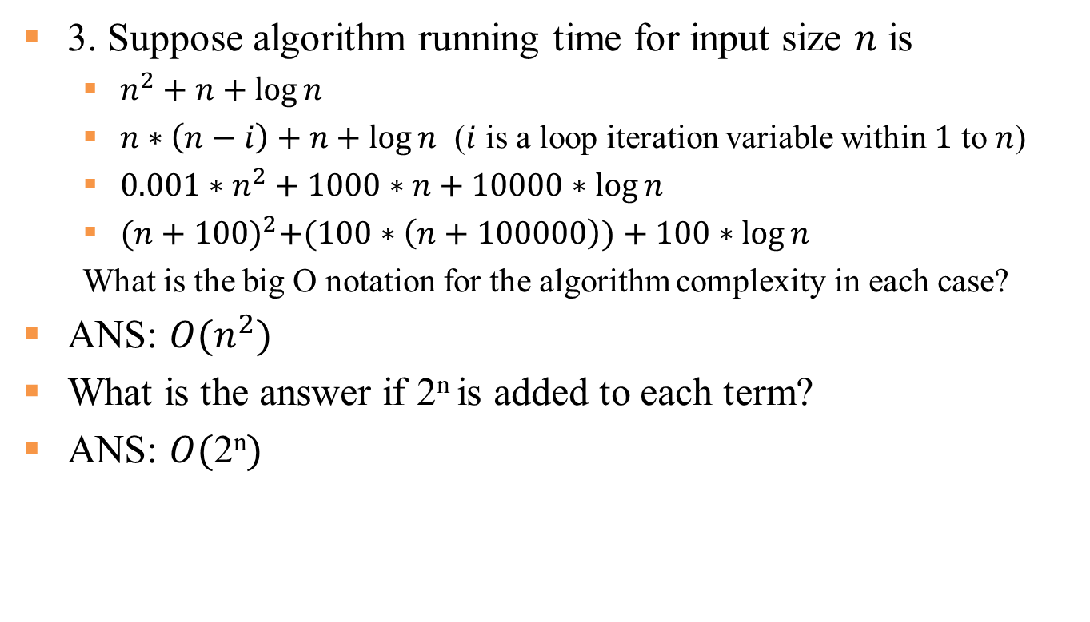
Exercise Con’t
3. Suppose algorithm running time for input size $n$ is
$n^{2}+n+\log{n}$
$n∗\left(n−i\right)+n+\log{n}$ ($i$ is a loop iteration variable within $1$ to $n$)
${0.001∗n}^{2}+1000∗n+10000∗\log{n}$
${(n+100)}^{2}+(100∗\left(n+100000\right))+100∗\log{n}$
What is the big O notation for the algorithm complexity in each case?
ANS: ${O(n}^{2})$
What is the answer if 2^{n} is added to each term?
ANS: $O(\text{2}\text{n})$
11

Slide 12
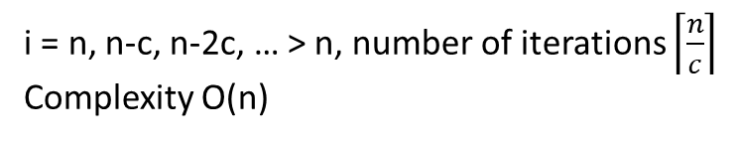
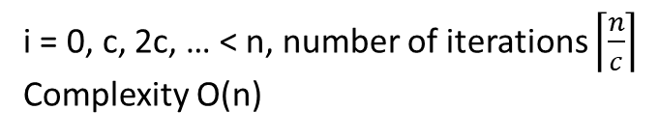
Loop Complexity Analysis Examples
for (int i = 0; i < n; i = i+c) {
//Some O(1) code
}
i = 0, c, 2c, … < n, number of iterations $\left\lceil \frac{n}{c}\right\rceil$
Complexity O(n)
for (int i = n; i > 0; i = i-c) {
//Some O(1) code
}
i = n, n-c, n-2c, … > n, number of iterations $\left\lceil \frac{n}{c}\right\rceil$
Complexity O(n)
for (int i = 1; i < n; i = i*c) {
//Some O(1) code
}
i = c⁰, c¹, c², …, c^{k-1} < n, number of iterations k < log_{c}n+1
Complexity O(log_{c}n). As the base does not
for (int i = n; i > 1; i = i/c) {
//Some O(1) code
}
i = n/c⁰, n/c¹, n/c², …, n/c^{k-1} > 1, number of iterations k < log_{c}n+1
Complexity O(log_{c}n)
12

Slide 13
Consecutive Loops
The first for loop finds the minimum value of input array vals with size n. It runs for n iterations, each taking constant time O(1), hence it has linear complexity O(n).
The second for loop reduces each value in the array by the minimum value. It runs for n iterations, each taking constant time O(1), hence it has linear complexity O(n).
e.g., vals = [1,2,5,3] before, [0,1,4,2] after.
Two assignment statements each has complexity O(1)
Total complexity of the entire algorithm is linear O(n) (the result of O(n)+O(n)+O(1)+O(1)).
void reduce (int[] vals) {
int minIndex =0;
for (int i=0; i < vals.length; i++) {
if (vals[i] < vals[minIndex]){
minIndex = i;
}}
int minVal = vals[minIndex];
for (int i=0; i < vals.length; i++){
vals[i] = vals[i] - minVal;
}
}
O(1)
+
O(n)
+
O(1)
+
O(n)
+
13

Slide 14
Nested Loops
int maxDifference (int[] vals) {
int max = 0;
for (int i=0; i < vals.length; i++) {
for (int j=0; j < vals.length; j++) {
if (vals[i] – vals[j] > max) {
max = vals[i] – vals[j];
}
}
}
return max;
}
The nested for loops look for the maximum difference between any two array elements of input array vals with size n:
e.g., vals = [1,7,2,4,6,8], return 8 – 1 = 7
Inner loop runs for n iterations, each taking constant time O(1), hence it has linear complexity O(n).
Outer loop runs for n iterations, each taking linear time O(n), hence it has quadratic complexity O(n²).
O(1)
O(n)
O(n²)
O(1)
14

Slide 15
Exercises
int fun (int n) {
for (int i = 0; i < n; i = i+c) {
//Some O(1) code
}
for (int i = 0; i < n; i = i*2) {
//Some O(1) code
}
for (int i = 0; i < 100; i = i++) {
//Some O(1) code
}
}
First loop has complexity O(n)
Second loop has complexity O(log n)
Third loop has complexity O(1)
Total complexity is O(n), result of O(n)+O(log n)+O(1)
int fun (int n) {
for (int i = 0; i < n; i++) {
for (int j = 1; j < n; j = j*2) {
//Some O(1) code
}
}
}
Inner loop has complexity O(log n)
Outer loop has complexity O(n)
Total complexity is O(n log n), result of O(n)*O(log n)
15

Slide 16
Exercises Con’t
int fun (int n) {
for (int i = 0; i < n; i++) {
for (int j = 1; i < n; j = j*2) {
//Some O(1) code}
}
for (int i = 0; i < n; i++) {
for (int j = 1; j < n; j++) {
//Some O(1) code}
}
}
First nested loop has complexity O(n log n)
Second nested loop has complexity O(n²)
Total complexity is O(n²), result of O(n log n) + O(n²)
int fun (int n) {
for (int i = 0; i < n; i++) {
for (int j = 1; i < n; j = j*2) {
//Some O(1) code}
}
for (int i = 0; i < m; i++) {
for (int j = 1; j < m; j++) {
//Some O(1) code}
}
}
First nested loop has complexity O(n log n)
Second nested loop has complexity O(m²)
Total complexity is O(n log n + m²), result of O(n log n) + O(m²)
16

Slide 17
Best-case, Average-case, Worst-case Complexity
Best-case complexity: best possible performance of algorithm for any input of size n
Worst-case complexity: worst possible performance of algorithm for any input of size n
Average-case complexity: performance on average, consider all possible inputs of size n
Often mathematically difficult to analyze
In big-O notation, Best-case complexity ≤ Average-case complexity ≤ Worst-case complexity
17

Slide 18
Best-case, Average-case, Worst-case Complexity Example 1
boolean hasLetter(String word, char letter)
{
for (int i = 0; i < word.length(); i++) {
if (word.charAt(i) == letter) {
return true;
}
}
return false;
}
Algorithm complexity w.r.t input size n = word.length(), for Best-case, Average-case, and Worst-case.
Best-case: O(1), if word starts with letter
hasLetter("apple", "a");
Worst-case: O(n), if letter at the end (or missing)
hasLetter("happy", "x");
hasLetter("happy", ”y");
Average-case: O(n), assuming letter may take on any random value
18
Notes:
- algorithm performance depends on the combination of both inputs

Slide 19
Best-case, Average-case, Worst-case Complexity Example 2
int getSum (int arr[], int n)
{
if (n%2 == 0) {
return 0; }
int sum = 0;
for (int i=0; i<n; i++) {
sum += arr[i]; }
return sum;
}
Algorithm complexity w.r.t input n = size of input array arr[], for Best-case, Average-case, and Worst-case, for a made-up function that returns 0 for even n, and sum of array elements for odd n. (So the name getSum() is not accurate.)
Best-case: O(1), if n is even (n%2 == 0)
Worst-case: O(n), if n is odd (n%2 != 0)
Average-case: O(n), assuming n may be even or odd with equal chance
19
Notes:
- algorithm performance depends on the combination of both inputs

Slide 20
Analyzing Search Algorithms
 | Best Case | Worst Case
Linear Search
Binary Search*
# times to half size?
O(1)
O(n)
How many times can we divide by 2 before we get to 1?
O(1)
O(log(n))
* Assuming data is sorted
sorting cost?
Binary Search: Basic Algorithm
Initialize low = 0, high = length of list
while low <= high:
mid = (high+low)/2
if toFind matches value at mid,
return true
if toFind < value at mid
high = mid-1
else low = mid+1
return false
Cuts search base in half at each iteration, so the total # iterations is log₂(n)
Linear Search: Basic Algorithm
Start at the first index in the array
while index < length of the array: if toFind matches current value,
return true
increment index by 1
return false
first half
second half
E.g. hasLetter(String word, char letter)
Worst case: don't find!
Binary search in 4 minutes
https://www.youtube.com/watch?v=fDKIpRe8GW4
20

Slide 21
Additional Resources
Big-O analysis
http://web.mit.edu/16.070/www/lecture/big_o.pdf -- Big O handout from MIT
https://www.interviewcake.com/article/java/big-o-notation-time-and-space-complexity -- explanation of Big O with examples
http://discrete.gr/complexity/ -- "A Gentle Introduction to Algorithm Complexity Analysis" GIves a lot more detail than what we provided.
Sorting algorithms
http://www.java2novice.com/java-sorting-algorithms/ -- 5 different sort algorithm explanation with codes
https://www.cs.cmu.edu/~adamchik/15-121/lectures/Sorting%20Algorithms/sorting.html -- different search algrotihms with solid examples
Timing code in Java
http://stackoverflow.com/questions/180158/how-do-i-time-a-methods-execution-in-java -- many ways offered by many people
21

